Slide 1
Tell the Story Deck Updated: Verituity - Data Visualization
Ruchi Amin, Suyash Shrivastava, Prithak Bhattacharyya, Brooke McDermott, & Ayushi Chauhan
• 04.05.2022

Slide 2

Company Background
About Verituity
Verituity transforms payouts beyond transactions into new sources of value, by delivering faster, safer, verified payments and pay-by-anything experiences, all while reducing payout complexity, risks, and lowering costs.

Slide 3
Company Background
VERIFY: Faster, safer, verifies payouts
pay right to the payee, the right account, on time, the first time
reduce payment fraud, errors, and expectations
enhance security compliances
PAYOUT: Dynamic policy automation & orchestration
turnkey, dynamic payout instruction and processing
enables a secure, pay-by-anything, anywhere customer experience
ENGAGE: Branded, custom experiences
engage payees in the context of the payer’s brand
dynamic payment choice: ACH, Wire, Zelle, RTP, push to debit, virtual card, and check
frictionless experiences, mobile and web

Slide 4
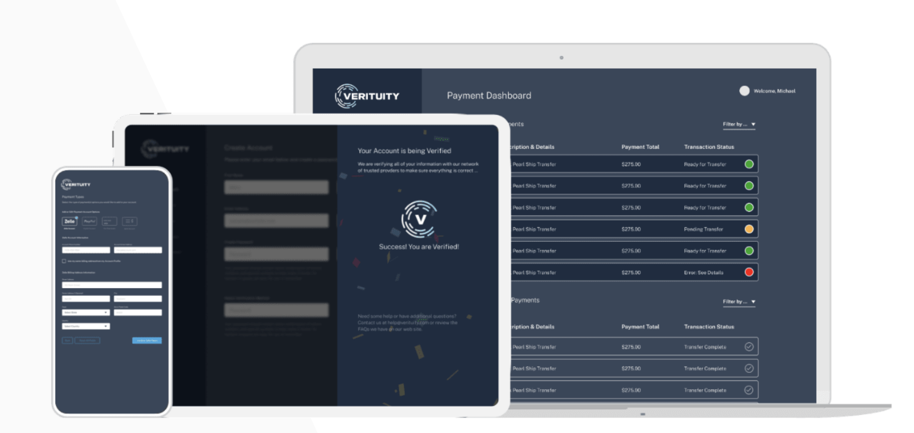
Company Background
Verituity’s verified payout platform connects Banks, Payers, and Payees through a digital, intelligent platform that places contextual verification and an adaptive policy engine at its core. We uniquely strengthen payout speed, accuracy, and visibility, and deliver pay-by-anything and anywhere payment choice, all while reducing complexity, risks, and costs.

Slide 5
Company Background - Paypocket
PayPocket offers a service to retailers to add to their customers as a value add.
Paypocket provides customers active price matching on all purchased products at checkout.
If the customer opts-in to the service, PayPocket scans for a lower price for 30 days.
If a lower price is found, Paypocket initiates a customer payout for the difference.
When the customer purchases the item online, the retailer collects your email, first name, middle name (optional), and last name plus certain characteristics of the purchase and shares the information with PayPocket.
Payment method is not shared due to data privacy restrictions.
To receive a payout from PayPocket, the consumer logs in to the PayPocket site to claim the payout and sets-up a payout account (checking, PayPal, Zelle) to receive their rebate.

Slide 6
Business Problem
Vertuity does not have an understanding of their payouts
Negative impacts
Lack of knowledge
Can not update code to correct errors
Can not market to untapped demographics
Unable to predict future payouts
Unable to have a sales ready portfolio

Slide 7
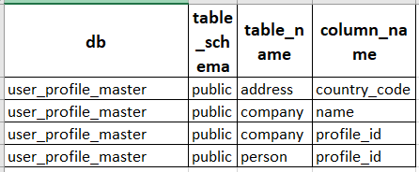
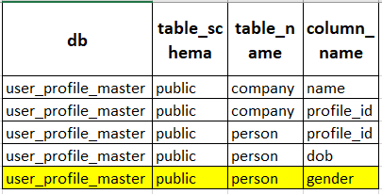
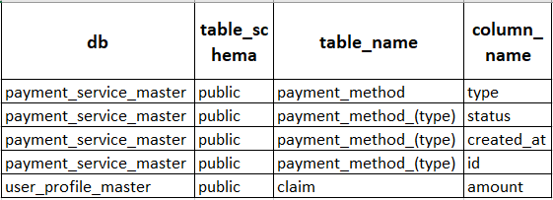
Data Development
It is important to use different data dictionaries for different dashboards.
3. Payment type distribution
2. Personal Demographics
Country

Slide 8
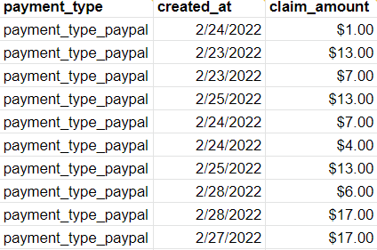
Model Overview
Synthetic Data was created for each dashboard

Slide 9
Model Overview
Software being used
Power Bi
Free to download
Limited to microsoft software
Not every dashboard can be downloaded
Only collaborate with the same Domain
Tableau
Need a licensure
Compatible on Mac and Windows
Easy to download and share
Can collaborate with anyone

Slide 10
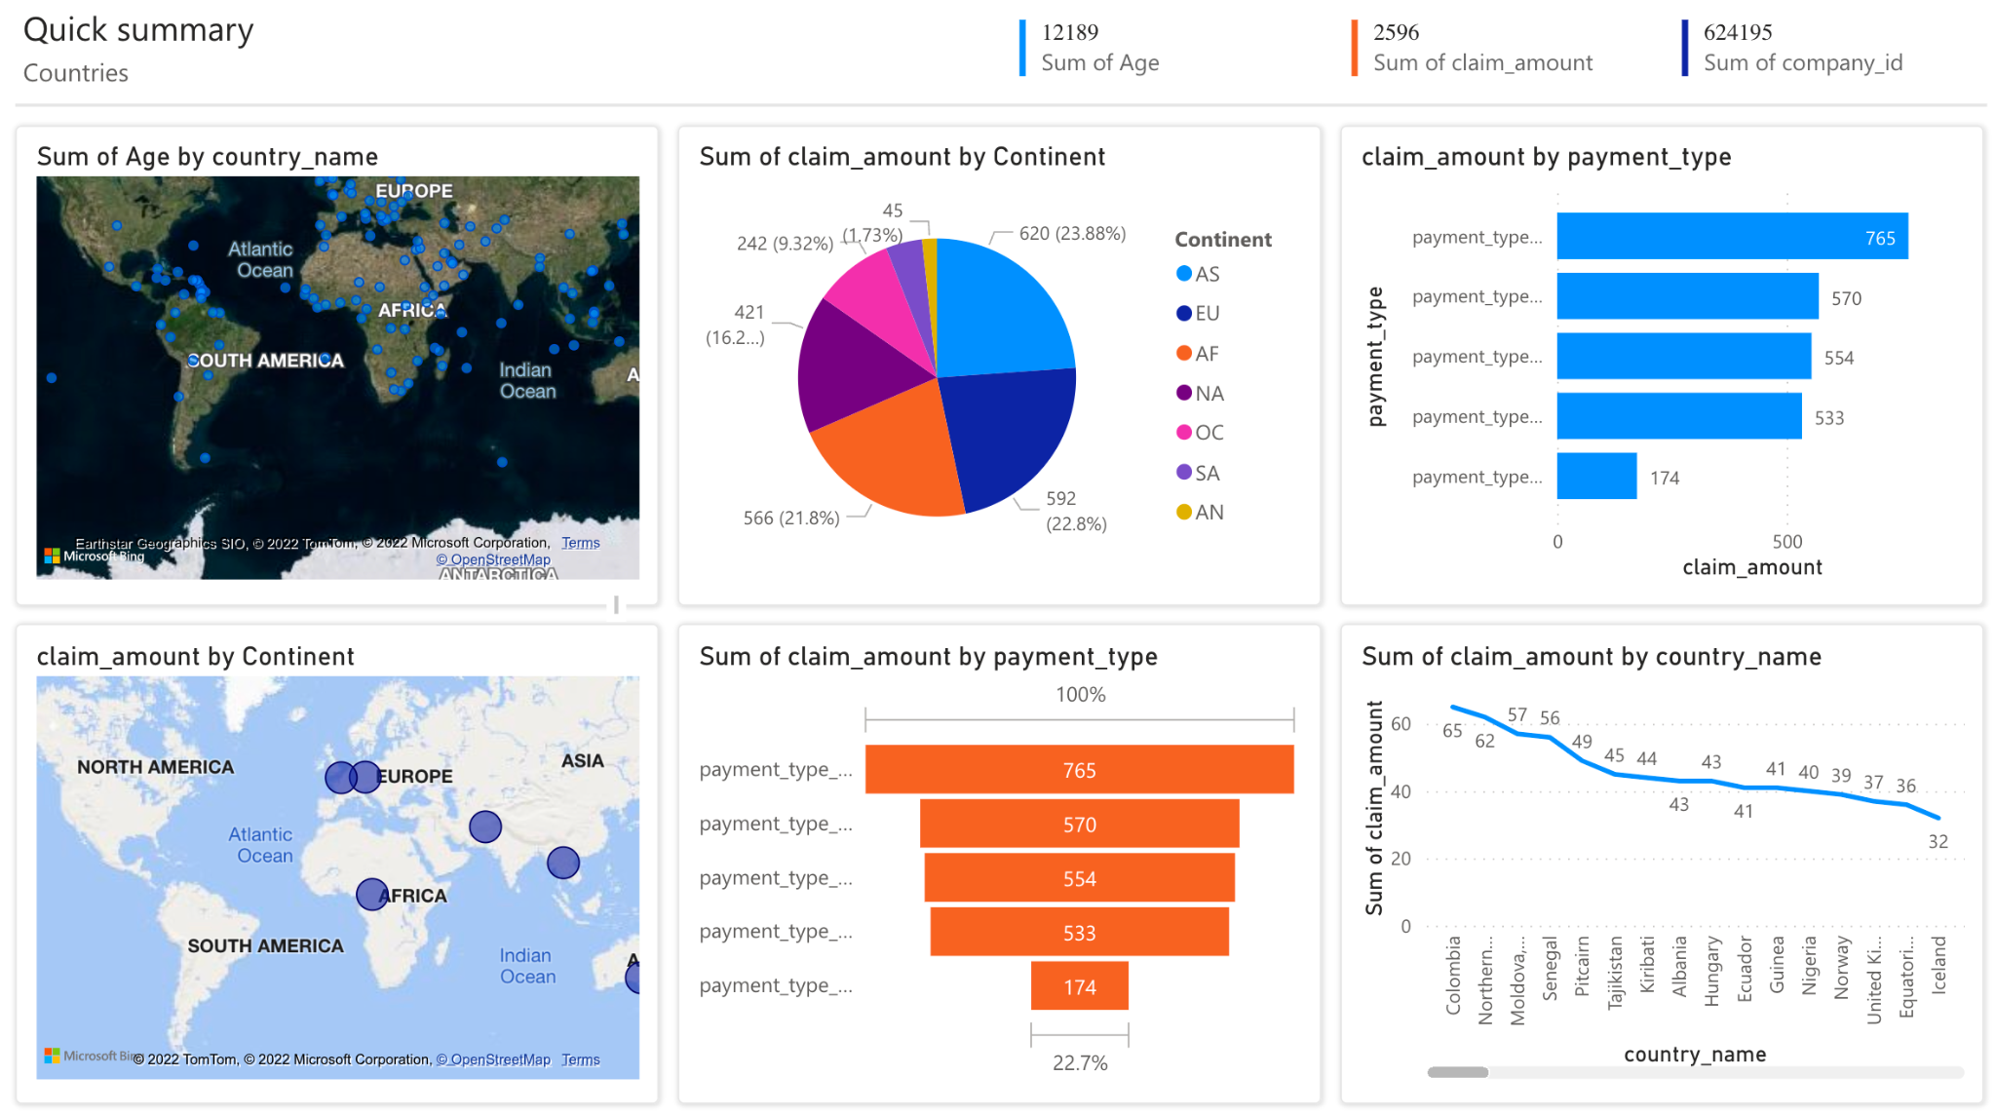
Dashboards: Countries and companies using PowerBI

Slide 11
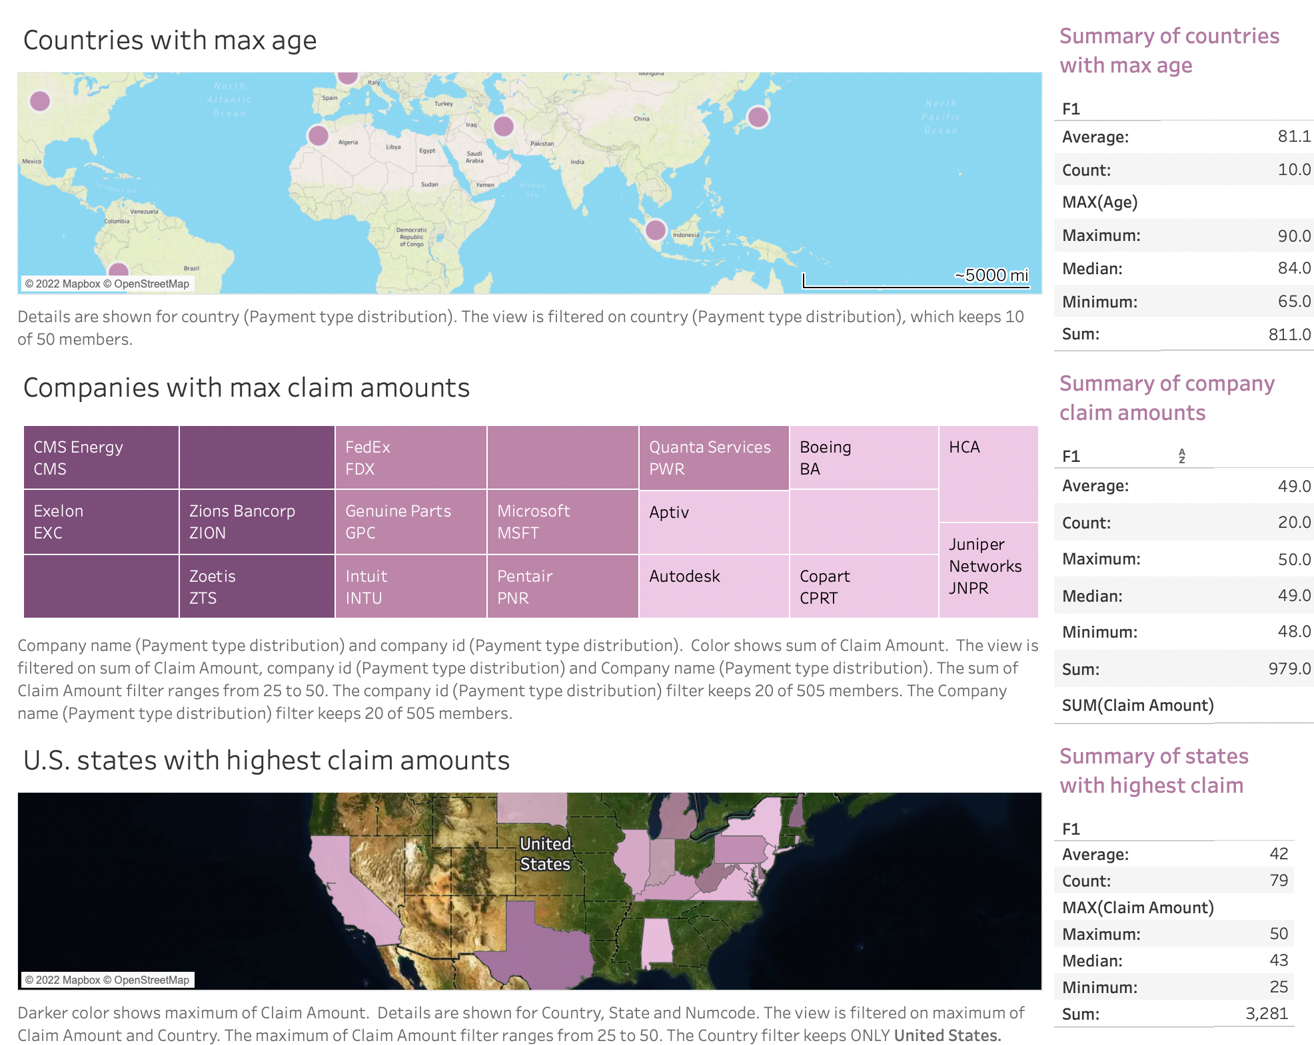
Dashboards: Countries and companies using Tableau

Slide 12
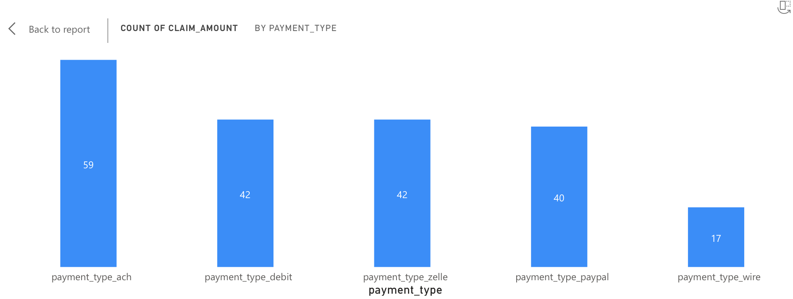
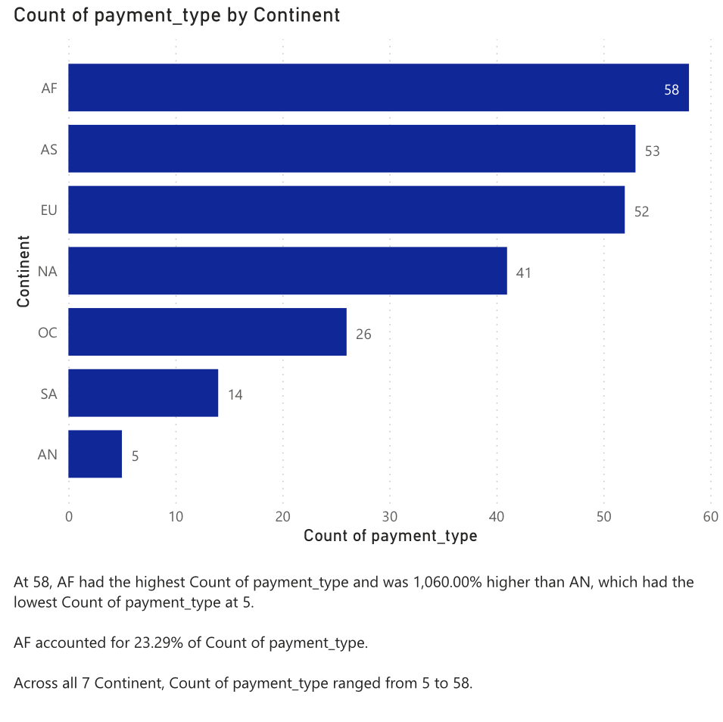
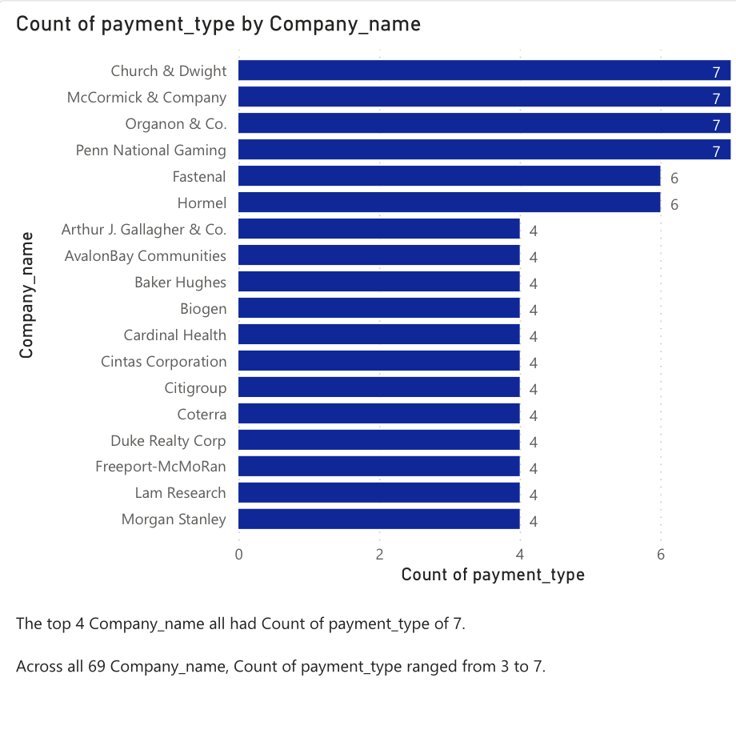
Dashboards: Payment Type Distribution

Slide 13
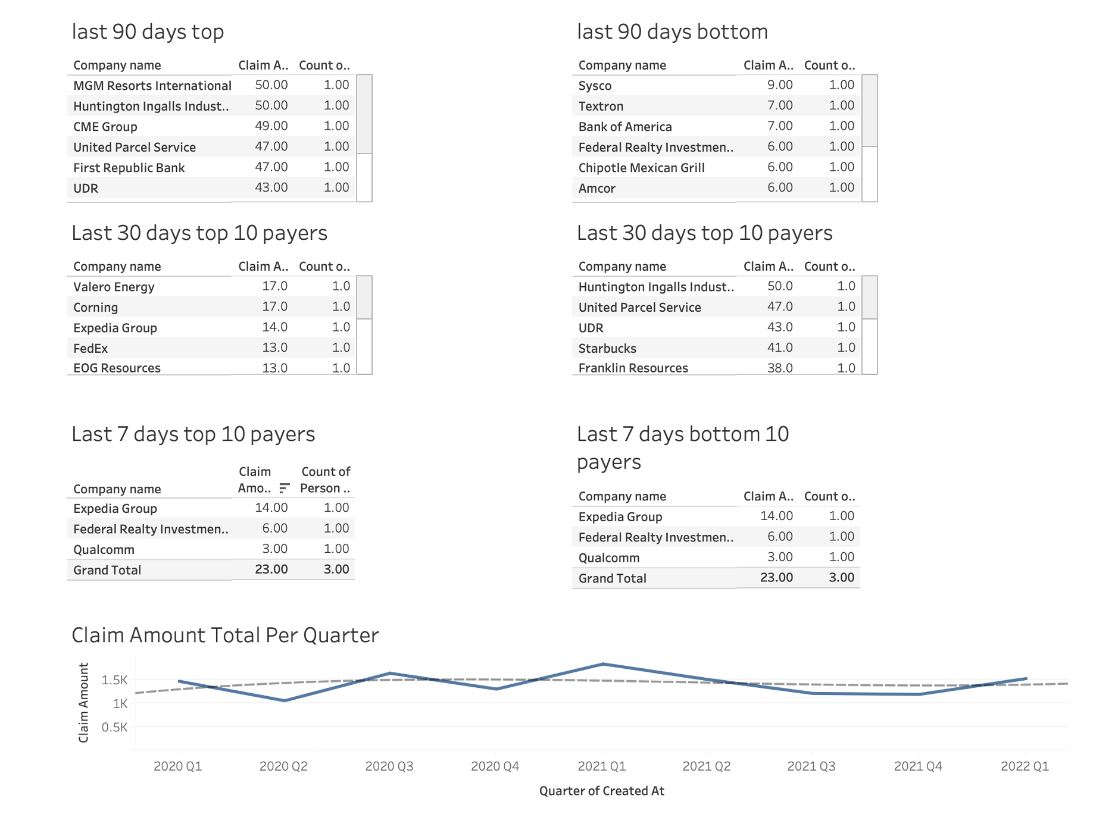
Dashboards: Payer Transactions

Slide 14
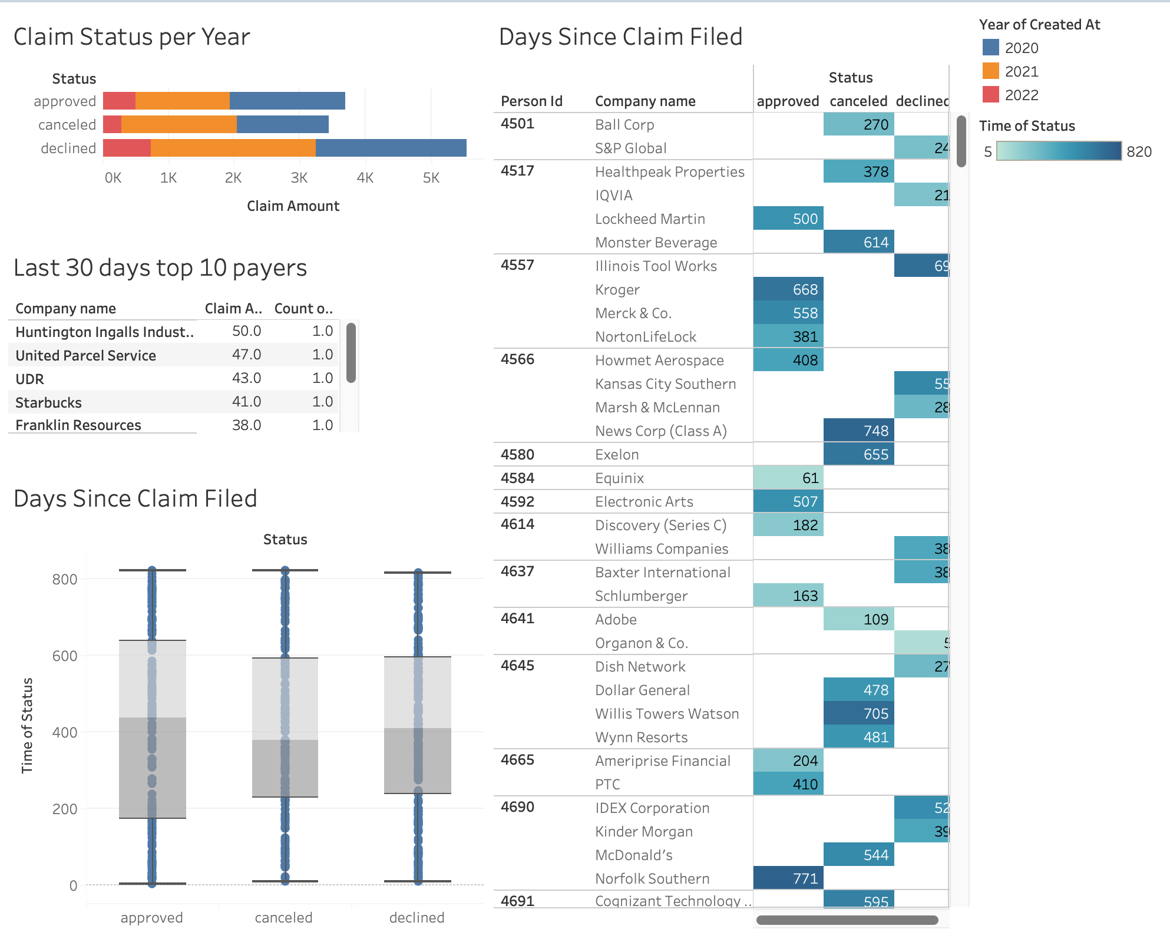
Dashboards: Payer Transactions

Slide 15
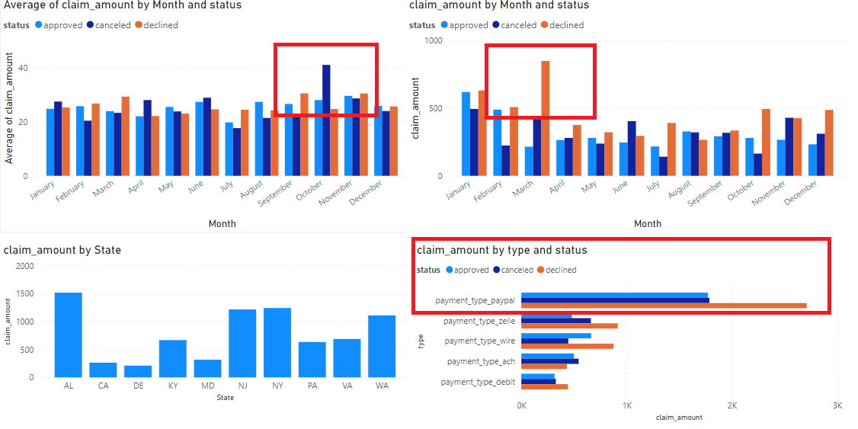
Dashboards: Claim Amount status

Slide 16
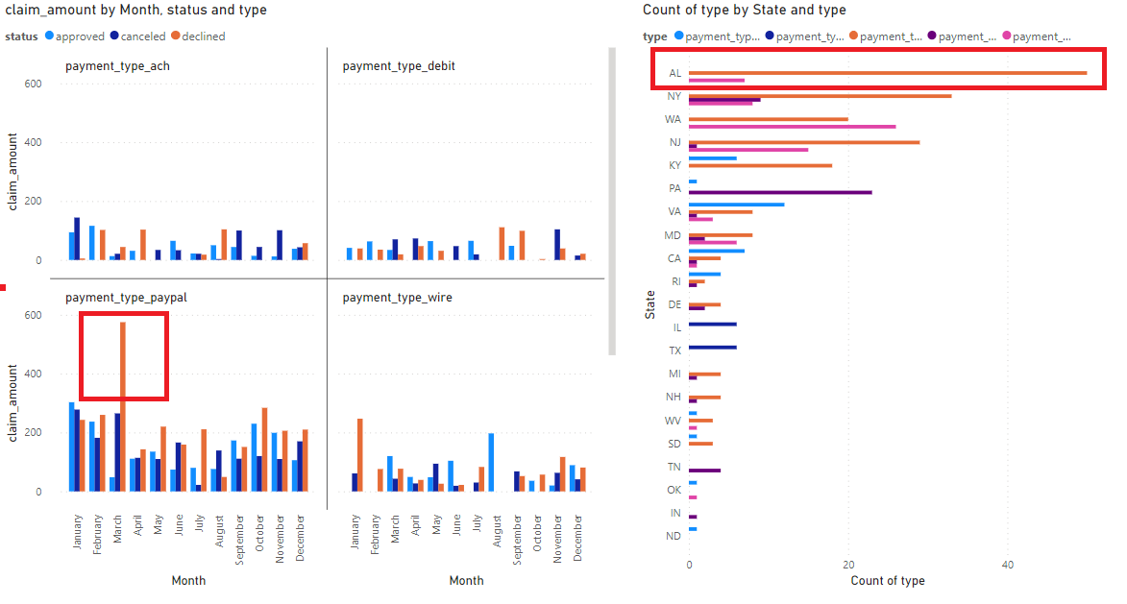
Dashboards: Status when Declined

Slide 17
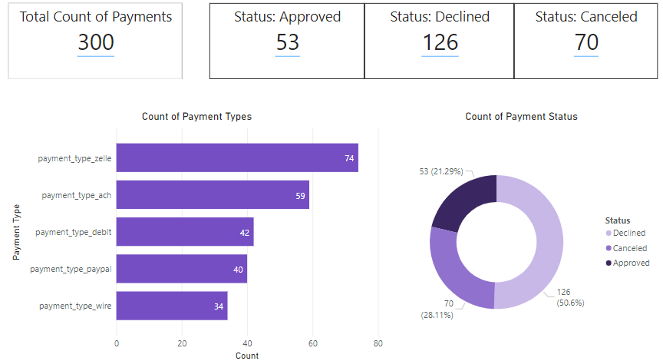
Dashboards: Payment Status Summary

Slide 18
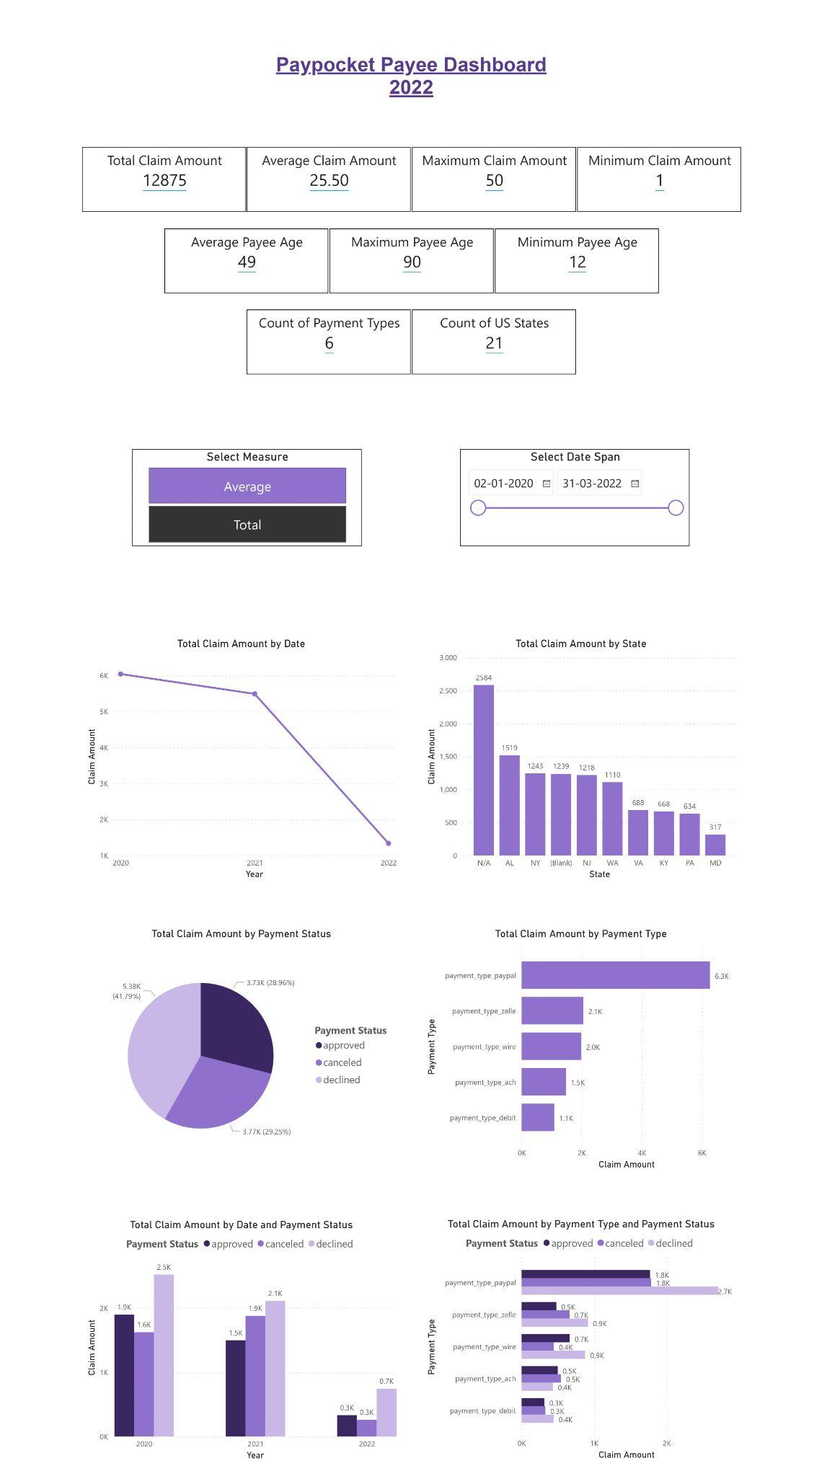
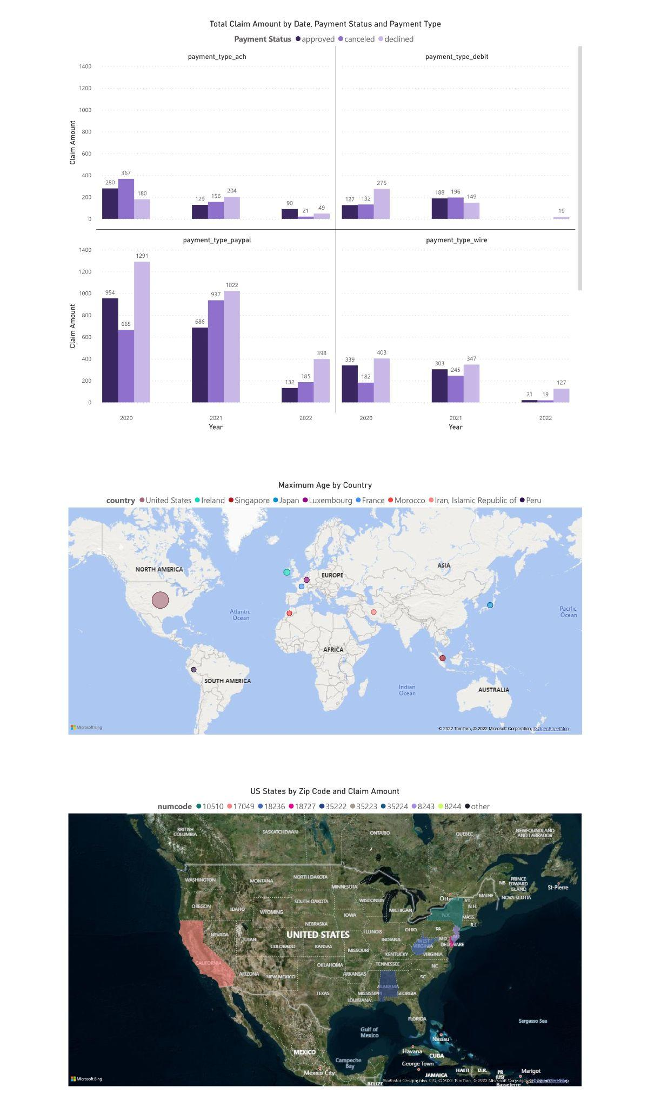
Dashboard: Payee
The link to the pdf version of the dashboard is as follows:
https://drive.google.com/file/d/1TMuQRJD1eGPwLs6n81fFUpNZ2UrhCSIc/view?usp=sharing

